Slide 1

B.tech Project External Evaluation ,VIIIth Sem
STROKE PREDICTION
Presented by
AKHIL SIBI, 2018008191
KEVIN SABU, 2018004754
ANIKET SHUKLA, 2018006541
Supervised by
JYOTSNA SETH , Asst. Professor (CSE)
Sharda University, Gr. Noida
DEPARTMENT OF COMPUTER SCIENCE & ENGINEERING
SCHOOL OF ENGINEERING AND TECHNOLOGY
May 13, 2022

Slide 2
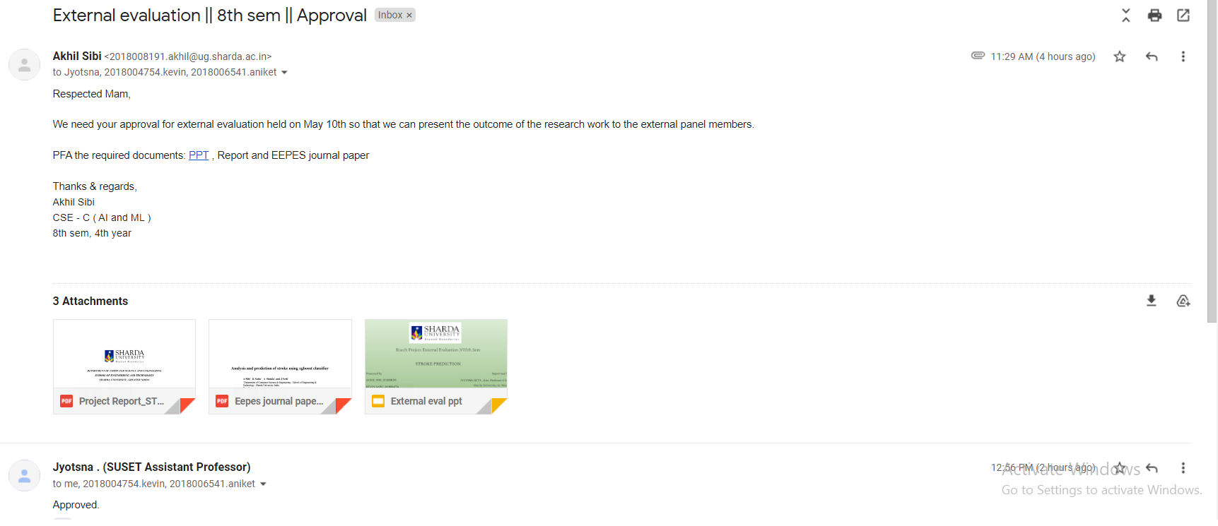
Approval from guide for the evaluation
Figure 1. Screenshot of the approval in mail by the guide

Slide 3
Contents of the Presentation
Workload distribution
Introduction
Software Requirements specifications
Literature review
Design
Methodology
Results
Conclusion
Project outcome
Project report
Github link
References

Slide 4
WORKLOAD DISTRIBUTION
AKHIL SIBI : 60% Journal paper , 50% implementation , 50% project report
ANIKET SHUKLA : 20% Journal paper , 25 % implementation , 25% project report
KEVIN SABU : 20% Journal paper , 25 % implementation , 25% project report

Slide 5
INTRODUCTION
Stroke is the second leading cause of death worldwide, accounting for approximately 11% of all deaths, according to the World Health Organization (WHO). It causes difficulty walking and speaking, as well as facial paralysis or numbness, and the patient's life expectancy ranges from 1 to 5 years.
The early prediction of stroke incidence is a critical component of our research work because it allows us to avoid the worst-case scenario and provide proper treatment at the right time. The dataset is open source, taken from Kaggle and attributed to the Author: 'fedesoriano'
Our Proposed approach is the comparative analysis of various machine learning classifiers that are trained, tested, and tuned with hyperparameters and finding out which is the best classifier. Choosing the classifiers for modeling the prediction system will be based on a review of past research works, which will provide us with the essential information and knowledge to move forward with the project.

Slide 6
SOFTWARE REQUIREMENTS SPECIFICATIONS
Software requirements specification (SRS) is a Technical document that specifies the functionality of a piece of software or a product to stakeholders and customers. It is completed prior to the design process, and the document discusses the product's functional and nonfunctional needs, who is targeted for the product launch based on a market survey, and how the product will contribute to the company's growth and profitability. While developing the prediction system, we considered the various types of requirements, such as functional and nonfunctional requirements, as well as how they interact with one another, in order to create a personalized and realistic prediction system that will accurately predict the chances of stroke when given patient data.
FUNCTIONAL REQUIREMENTS
for the integrity of our research work, the prediction system must have an accuracy of more than 90% while making predictions on the testing dataset or the inputs provided, because accuracy matters a lot in the field of medicine or any other, and so good accuracy ensures the software's reliability to make the right predictions.
Prediction system should be able to provide accurate results in a short period of time, in terms of seconds.

Slide 7
NON FUNCTIONAL REQUIREMENTS
RELIABILITY: There should be no manipulation with test results within the prediction system, and the test findings on stroke should always be accurate to the point so that the doctor can make the correct diagnosis.
PERFORMANCE: In this fast-paced world and in the medical profession, performance matters, and failure to load the data or lag in the prediction system will only slow the diagnosis of patients who are at risk of having a stroke in the future.
HARDWARE AND SOFTWARE SPECIFICATIONS
Our study hardware is a simple, efficient laptop with an i5 8th gen processor, a minimal graphic card, and 8gb ram. Good internet access ensured the seamless operation of the study for research and training of the models in Google colab notebook, and university access to extra hardware resources such as computer labs, etc. facilitated the growth of our work in the field of stroke.
Instead of Jupyter notebook, we chose Google Colab notebook, which is cloud-based and provides free access to powerful GPUs in the cloud. The notebook also comes preinstalled with the necessary python libraries for machine learning, such as scikit learn, pandas, numpy, matplotlib, and so on, so we don't have to worry about installing them via pip.

Slide 8
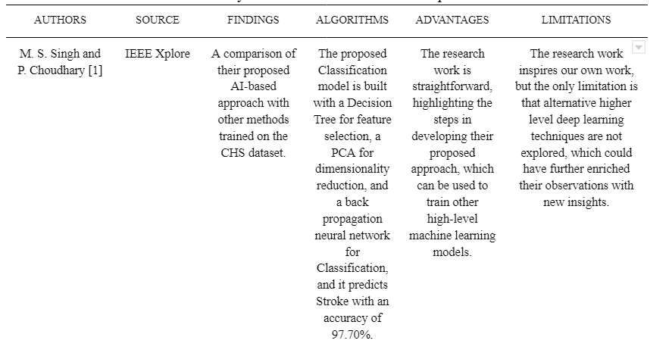
LITERATURE SURVEY
We did a thorough analysis of past studies in stroke prediction from a range of well-known sources, including IEEE, ScienceDirect, Research Gate, Scopus, and others, and compared them based on findings, algorithms used with accuracy, benefits, and limitations. The study helped us determine the most common risk factors for stroke occurrence. These past research works inspired us to create our prediction system, and the approaches used in these previous works aided us in investigating alternative powerful machine learning algorithms such as XGBoost, LightGBM, and CatBoost, among others.
Figure 2. survey of research works on stroke prediction

Slide 9
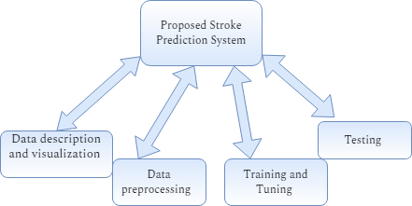
PROPOSED APPROACH
Our proposed method is to do a comparison study of several machine learning classifiers that have been trained, tested, and tweaked with hyperparameters to decide which classifier is the best. The identification of risk factors from datasets utilizing visualizations and training machine learning algorithms on these characteristics is crucial for successful prediction and understanding of stroke incidence. Our proposed approach ensures that the research activity coincides with novelty and that the end result is reached so that we may share the results with the scientific community in the form of a research paper and deploy the prediction system in real circumstances for the doctors to diagnose stroke patients.
Figure 3. proposed stroke prediction system

Slide 10
FEASIBILITY STUDY
The Feasibility study was completed very early in the project's development in order to assess the practicability of the proposed system and whether it would be successful in execution and delivery or not. We have covered all the aspects in the study ranging from Technical and Financial areas and have come to the conclusion that the research work is feasible to conduct and it will be a great progress in dealing with stroke and prediction of the stroke through early onset symptoms to save people’s lives.
RISK MANAGEMENT
Risks can arise while making our prediction system that can impact the performance of the models. These risks can range from low accuracy and ROC AUC scores etc and so to manage these risks , we have to balance the dataset in preprocessing using smote , hyperparameter tuning is essential during training so that to drastically increase the accuracy of the models on the testing dataset.

Slide 11
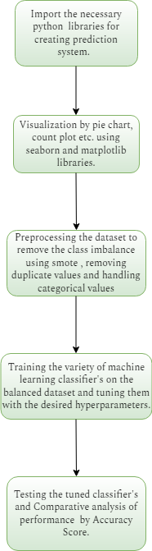
DESIGN
Designing the prediction system is a key component of the planning phase prior to implementation and coding since it allows us to envision how the system works, its behavior, and the actions required.
Figure 4 represents the flowchart which depicts the flow of the project from start to finish in a sequential manner AND These steps are clear, well thought out and concise enough that we have built the prediction system from scratch by following the methodology highlighted in the flowchart that ensured the positive success rate of the research work and ensured insightful , rich observations from the study
Figure 4. Flowchart of the Prediction system

Slide 12
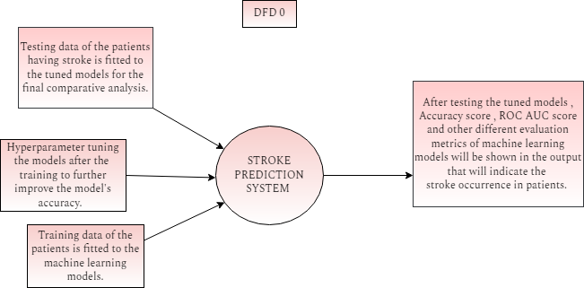
DFD
Data flow diagrams (DFDs) are graphical representations of system level designs that show the ins and outs of the flow of information or data and how the results will be generated from the inputs provided to the system. DFDs are very useful in the planning phase of SDLC, as well as in the requirement gathering phase, where visualization of the system's operation at various stages of DFD can guide the development of the product or software. Therefore we have shown a simple dfd 0 level diagram for our stroke prediction system that can help in understanding the inner workings of the system.
SDLC MODEL
For project management, we used Agile approach in which we divided the creation of the prediction system into several iterations , as shown in the flowchart, resulting in improved collaboration and project execution. Its advantages include efficient project management , promotes greater team collaboration and ensures work life balance and productivity of the employees
Figure 5. Level 0 DFD of Stroke prediction system

Slide 13
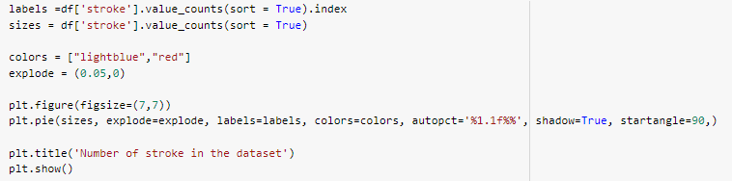
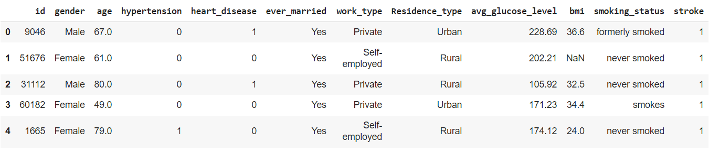
METHODOLOGY
Following the design of the prediction system, we proceeded with the implementation by following the research stages outlined in order to reach our study objective of comparison analysis.
Data description: we import the necessary python libraries for building our prediction system like Pandas , matplotlib etc. for reading and analyzing the dataset and visualizing the key risk factors affecting stroke occurrence.For our modeling, we use the Stroke Prediction Dataset from Kaggle , which contains 5110 Patient Records with feature characteristics related to the patient's lifestyle, such as BMI, Heart disease, hypertension, smoking, gender, and so on.
Data visualization: To highlight the relationship between the plotted features, we developed amazing visuals using matplotlib, seaborn libraries, and other tools. The major purpose is to raise awareness about stroke and how different clinical variables in the dataset play a significant effect in stroke incidence.
Figure 6. Dataset description
Figure 7. Countplot of stroke number

Slide 14
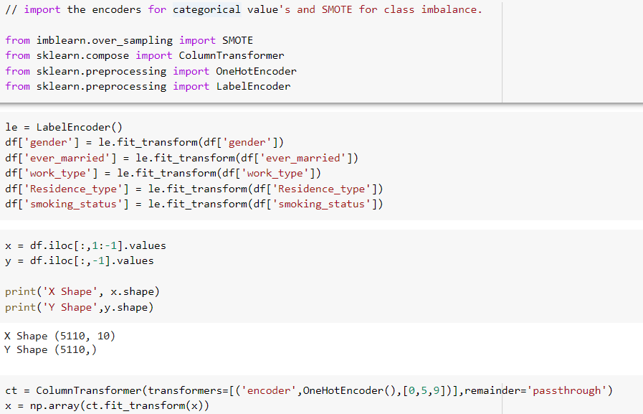
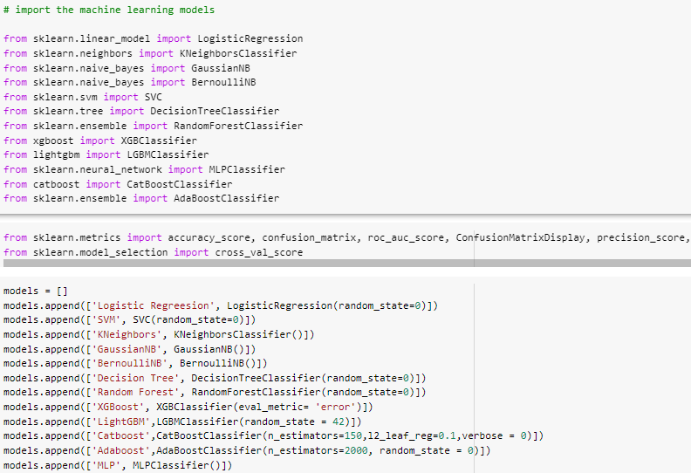
3) Data preprocessing: it is a very important and crucial step in data science and machine learning because the dataset is often imbalanced in nature, has duplicate and null values, and so it's a must to preprocess and clean the dataset very efficiently without losing the original data and so the first important step is to import the necessary libraries for preprocessing, such as LabelEncoder, OneHotEncoder, and ColumnTransformer, which will handle the Categorical values of the dataset and convert them to numerical, and finally we have SMOTE, which will balance the dataset for model training and improved performance.
4) Training: we import numerous types of machine learning classifiers from the sklearn library or pip install the relevant ones, which are as follows: XGBoost[15], LightGBM[19], CatBoost[20], Random Forest, AdaBoost, MLP, SVM, Logistic Regression, Decision Tree, KNeighbours, BernoulliNB, and GaussianNB. We will train and test each model, calculating its Accuracy Score, ROC AUC Score, Precision Score, Recall, F1 Score, and so on.)
Figure 8. Label encoders
Figure 9. Importing the classifiers for modeling

Slide 15
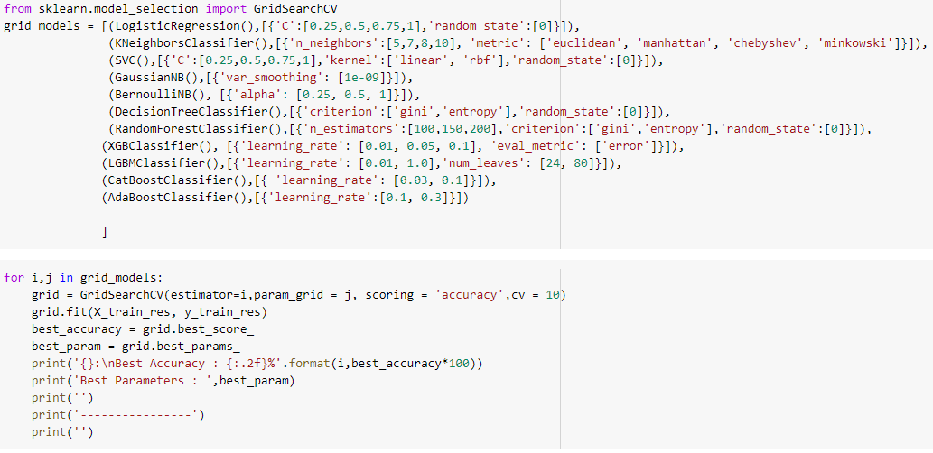
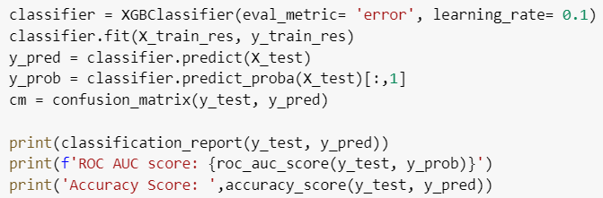
5) Tuning: To improve the accuracy and performance of the models even further, we will train them again on the dataset with the desired hyperparameters which will take some time to train. After Fine-tuning the models, we Fit the Testing data to see which one is the best. Hyperparameters chosen can range from Learning rate , evaluation metrics etc.
6) Testing: After tuning the models , we come to a conclusion that Random forest , CatBoost , XGBoost and LightGBM are having the best performance in terms of training accuracy and so it is obvious that for our final comparative analysis of the models on the testing dataset , we will test these four models mentioned and not take the other ones. Testing will be done on the basis of their accuracy score and ROC AUC score which will clearly reveal to us which is the best classifier for model building in the future where the system will be used in the real time deployment in hospitals.
The research methodology should be followed step by step, with careful consideration given to clean code, visualizations, model development, and tuning, so that we may have a good prediction system with minimal error, and all protocols, ethics, and regulations must be followed.
Figure 10. Tuning of the models with the desired parameters
Figure 11. Testing tuned XGBoost

Slide 16
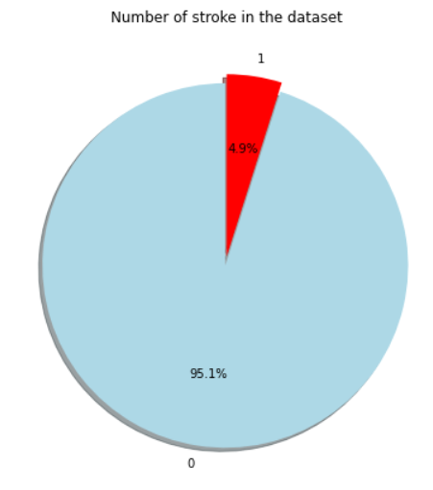
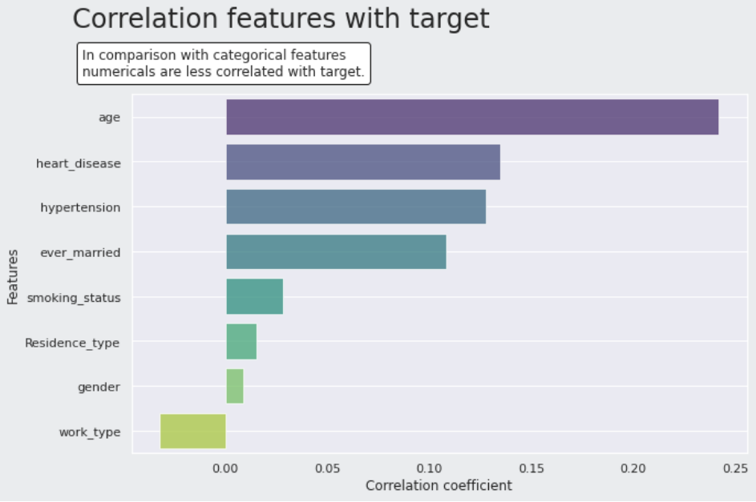
RESULT
So, first and foremost, we'd want to highlight the visualizations and plottings of the dataset features that were crucial in the connection of the features with stroke occurrence.
In this figure 17 is a pie chart plot of the number of people suffering from stroke in the dataset , we come to know only 4.9% suffer from stroke and are positive while 95.1% are negative with stroke and so it gives us a glimpse on the number of the stroke patients. So just like that , it will be followed by multiple other visualization on the clinical features of patients like work type , hypertension and smoking status etc and so in the figure , we have demonstrated the correlation of the clinical features or the risk factors that contribute to stroke from the dataset and as seen in the previous plottings and now this , we have come to know that with age , chances of stroke increases followed by heart Disease , hypertension and marital status etc and so with age , one should be cautious of their lifestyle habits
Figure 12. Pie Chart on number of stroke affected people
Figure 13. Correlation of features.

Slide 17
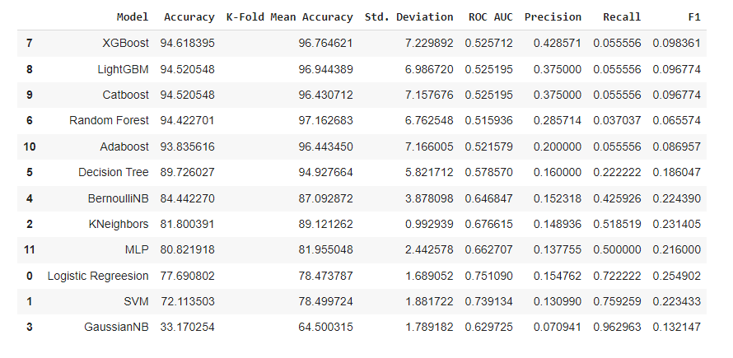
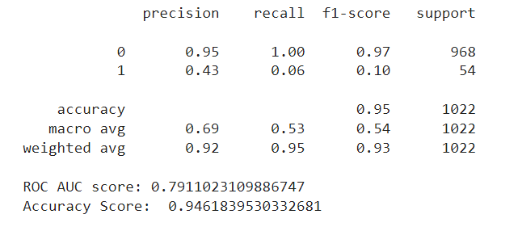
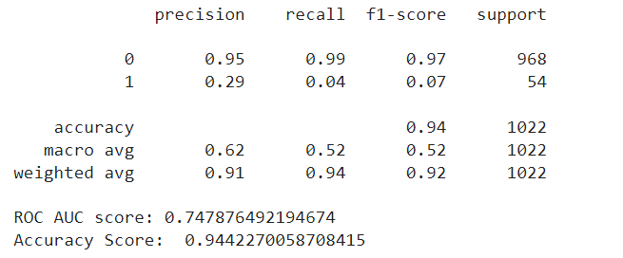
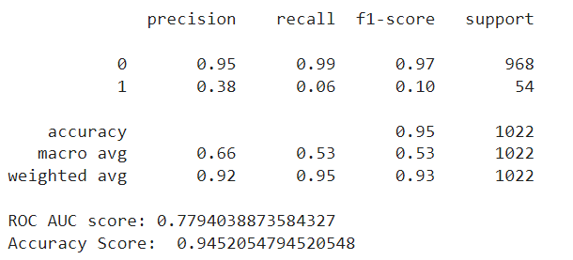
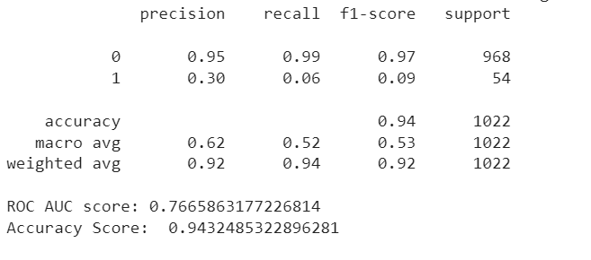
After visualization results , we have showcased the results of training and testing of the models before the tuning phase and seen in the figure 25 we compare the models performance with accuracy , ROC- AUC , K - Fold Mean Accuracy, Precision , recall , f1 score and standard deviation in which we have to only mind accuracy score and roc auc score and it is observed that XGBoost is the top performing model in terms of all the performance metrics highlighted having an accuracy score of 94.61% and roc auc score of 0.52 followed by LightGBM , Catboost , Random Forest and many others etc.
After this Tuning comes, which is an integral part of our research work that aims to further enrich the models accuracy and give us new observations on the performance of the models on the testing dataset .Therefore , we tune each one of the Classifiers with their Desired parameters ( Learning rate , n_estimators , eval_metrics , number of leaves etc ) using gridsearchcv so that we can further improve their performance and so after , we train them once again on the training dataset to note their training accuracy and so after training we observe that these four models which are XGBoost , Random forest , CatBoost and LightGBM stand out from others while achieving higher testing accuracy with their best defined parameter and so it stands to reason that we will only test these four to determine which model is the best for real-time stroke prediction and for comparative analysis purposes and so we fit the tuned and trained model on the testing dataset once again to see the improved accuracy score and roc auc score.
Figure 14. Comparative Analysis of Classifiers after training and testing
Figure 15. Tuned XGBoost performance
Figure 16. Tuned Random forest performance
Figure 17. Tuned LightGBM performance
Figure 18. Tuned CatBoost performance

Slide 18
CONCLUSION
Table 8.1 comparative analysis of tuned classifiers
From Figure 15 to 18 , we see the performance of these 4 Tuned models on the Testing data once again and so it is clear from the new observations that XGBoost is the best performing model on the stroke dataset during the comparative analysis and it achieves an impressive all rounder accuracy score of 94.61% and roc auc score of 0.79 and it is followed by LightGBM , Random forest and Catboost and their results are also neatly compiled in the below table for more clarity and so in conclusion these are the final results from our research work of comparative analysis on stroke dataset for the prediction system in which we have tried all the machine learning approaches and in the XGBoost emerged as the winner and best classifier for modeling of the prediction system.
XGBoost stroke prediction model should be integrated in real-time stroke prediction applications and hardware systems where it will produce accurate results since it has been vigorously trained , tuned and tested on the stroke dataset and has shown an impressive allrounder results
Model | Accuracy Score
Xgboost | 94.61 %
LightGBM | 94.52%
Random forest | 94.42 %
Catboost | 94.32 %

Slide 19

PROJECT OUTCOME
7th sem
Our project work is research-oriented, and the insights and results will be shared with the scientific community. For the 7th semester outcome, we had a simple research paper prepared in IEEE format, in which the results were neatly compiled, and then we submitted the paper to an IEEE conference named International conference of emerging technologies (INCET) in Bengaluru, but the paper was rejected during acceptance because some changes were required.
Figure 19. 7th sem research paper

Slide 20
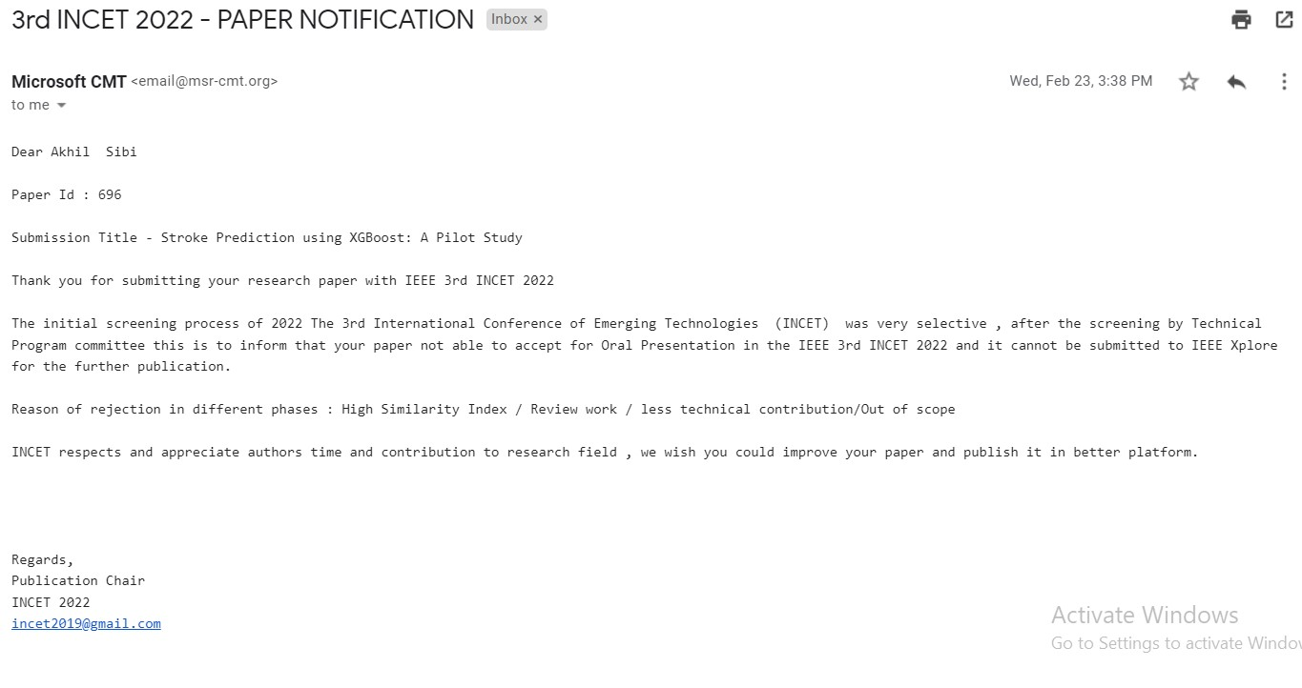
Figure 20. INCET Paper notification

Slide 21
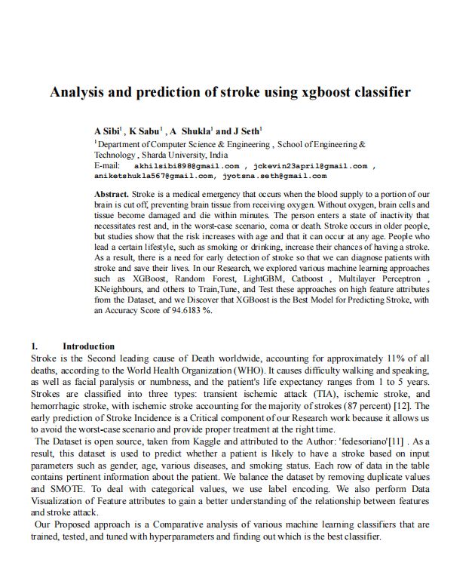
8th sem
Upon the feedback from INCET , In the eighth semester, we added four more classifiers to the comparative analysis, which were AdaBoost, CatBoost, LightGBM, and MLP neural network, among others, and we intricately formatted the paper from IEEE format to Journal of physics: Conference series, in which formatted and added more content to the literature review, results, and methodology, among others, and we submitted the paper to an International Conference on Electronics , Engineering Physics and Earth Science , 2022 ( EEPES ) held in hybrid mode
The good news is that our journal paper has been conditionally accepted in the prestigious EEPES conference and so we have to make the following revisions to the paper according to the editors and reviewers comments by May 30 and then we are all good to go for the conference and publication of our paper to the Journal of physics: Conference series.
Figure 21. 8th sem journal paper

Slide 22
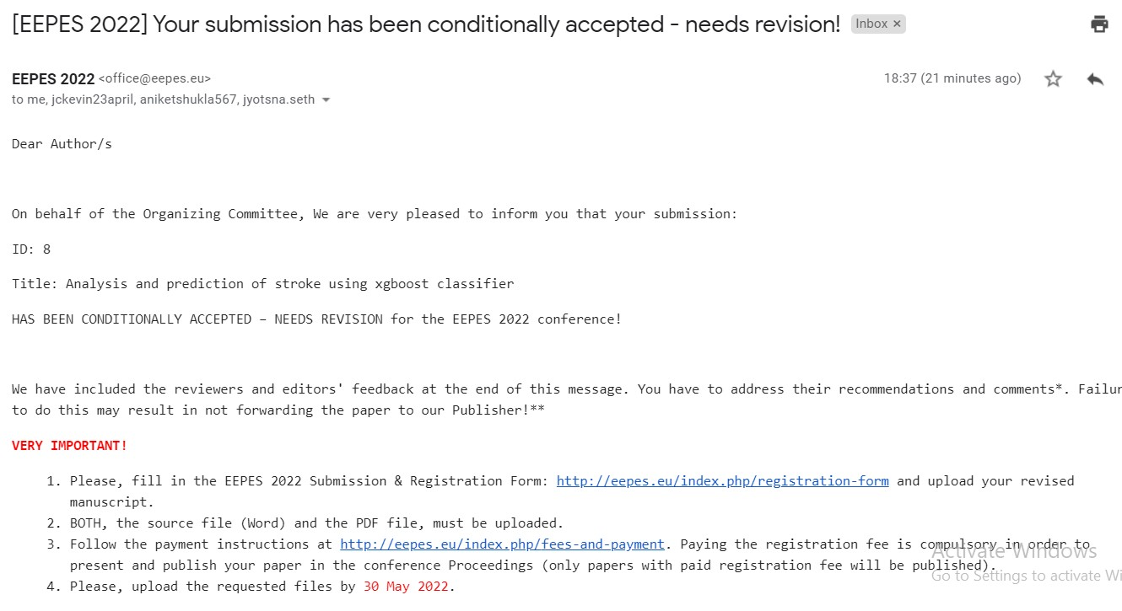
Figure 22. EEPES acceptance notification

Slide 23

PROJECT REPORT
The project report is well-organized, complete, and well-presented, with sections such as Introduction, Literature review, Design, Methodology, Result, Conclusion, and References. While writing our project report, we adhere to the project report format established by the CSE department.
Figure 23. Title page of project report

Slide 24
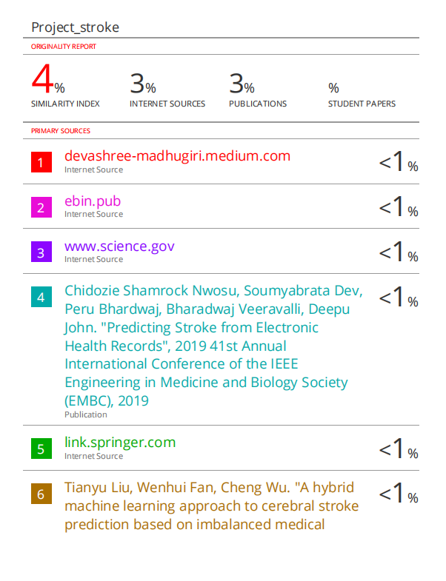
As shown in Figure 22, by running the Turnitin check on the project report, we achieved a similarity index of 4%, which is less than the 15% specified by the CSE department, indicating that the originality of the report is preserved throughout the writing process and the work done is of high quality.
Figure 24. Similarity index of the report

Slide 25
GITHUB LINK
The team also has uploaded the google colab notebook , project report and the ppt in the github repository , where they may be easily accessible and seen for future reference.
PFA the link : StrokePrediction_MajorProject

Slide 26
REFERENCES
M. S. Singh and P. Choudhary, “Stroke prediction using artificial intelligence,” 2017 8th Ind. Autom. Electromechanical Eng. Conf. IEMECON 2017, pp. 158–161, Oct. 2017, doi: 10.1109/IEMECON.2017.8079581.
C. H. Lin et al., “Evaluation of machine learning methods to stroke outcome prediction using a nationwide disease registry,” Comput. Methods Programs Biomed., vol. 190, p. 105381, Jul. 2020, doi: 10.1016/J.CMPB.2020.105381.
T. Liu, W. Fan, and C. Wu, “A hybrid machine learning approach to cerebral stroke prediction based on imbalanced medical dataset,” Artif. Intell. Med., vol. 101, p. 101723, Nov. 2019, doi: 10.1016/J.ARTMED.2019.101723.
S. N. Min, S. J. Park, D. J. Kim, M. Subramaniyam, and K. S. Lee, “Development of an Algorithm for Stroke Prediction: A National Health Insurance Database Study in Korea,” Eur. Neurol., vol. 79, no. 3–4, pp. 214–220, May 2018, doi: 10.1159/000488366.
N. V. Chawla, K. W. Bowyer, L. O. Hall, and W. P. Kegelmeyer, “SMOTE: Synthetic minority over-sampling technique,” J. Artif. Intell. Res., vol. 16, pp. 321–357, 2002, doi: 10.1613/JAIR.953.
T. Chen and C. Guestrin, “XGBoost: A scalable tree boosting system,” Proc. ACM SIGKDD Int. Conf. Knowl. Discov. Data Min., vol. 13-17-August-2016, pp. 785–794, Aug. 2016, doi: 10.1145/2939672.2939785.

Slide 27
THANK YOU !!!

